Slide 1
Inventory Management System
22AprEnable1
By Jasmin Willis

Slide 2
Project introduction
Project Fundamentals:
Create an inventory management system to showcase the skills we have learnt over the past 5 weeks.
Minimum Viable Project:
CRUD functionality for Customers, Orders and Items.
The Scope:
Jira scrum board for project management
UML and ERD(s)
MoSCoW
Risk assessment

Slide 3
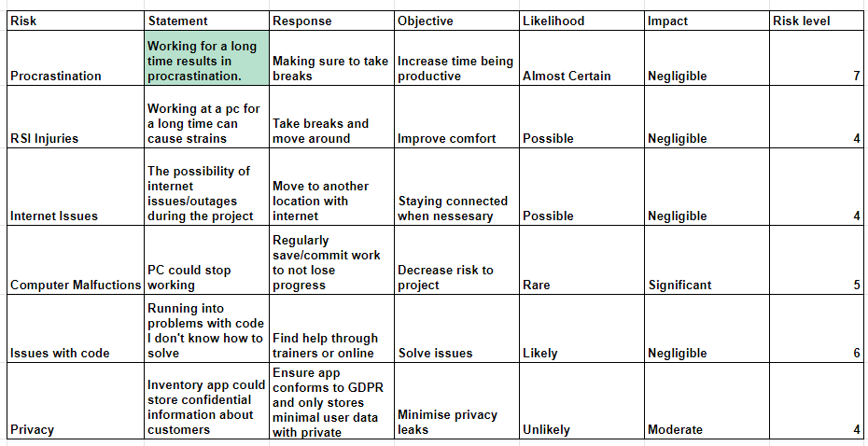
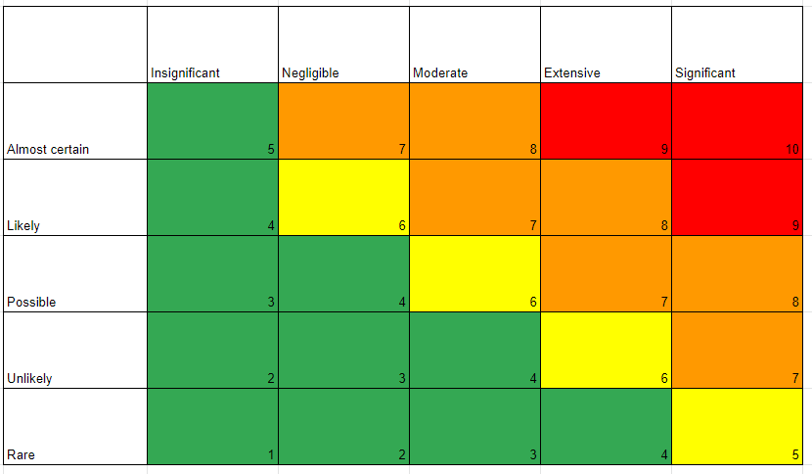
Risk Matrix

Slide 4
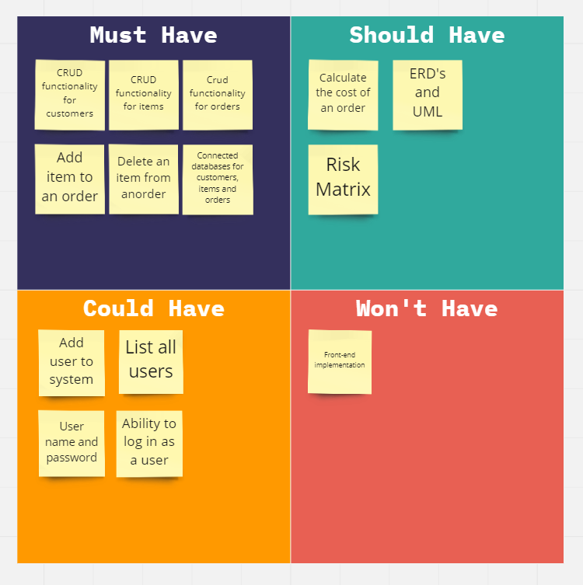
MoSCoW

Slide 5
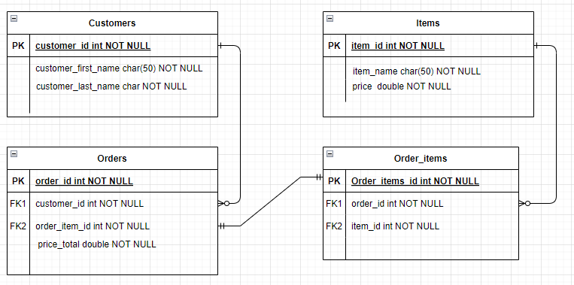
Entity Relationship Diagram - Initial

Slide 6
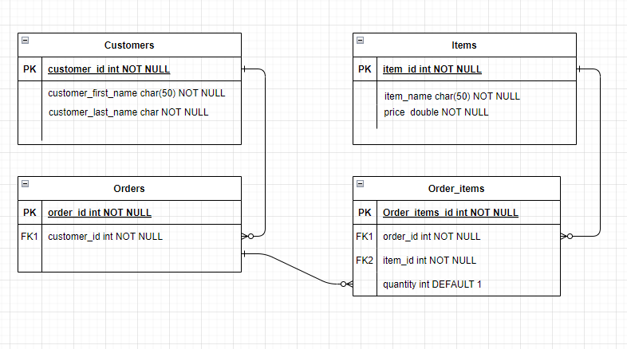
Entity Relationship Diagram - After completion

Slide 7
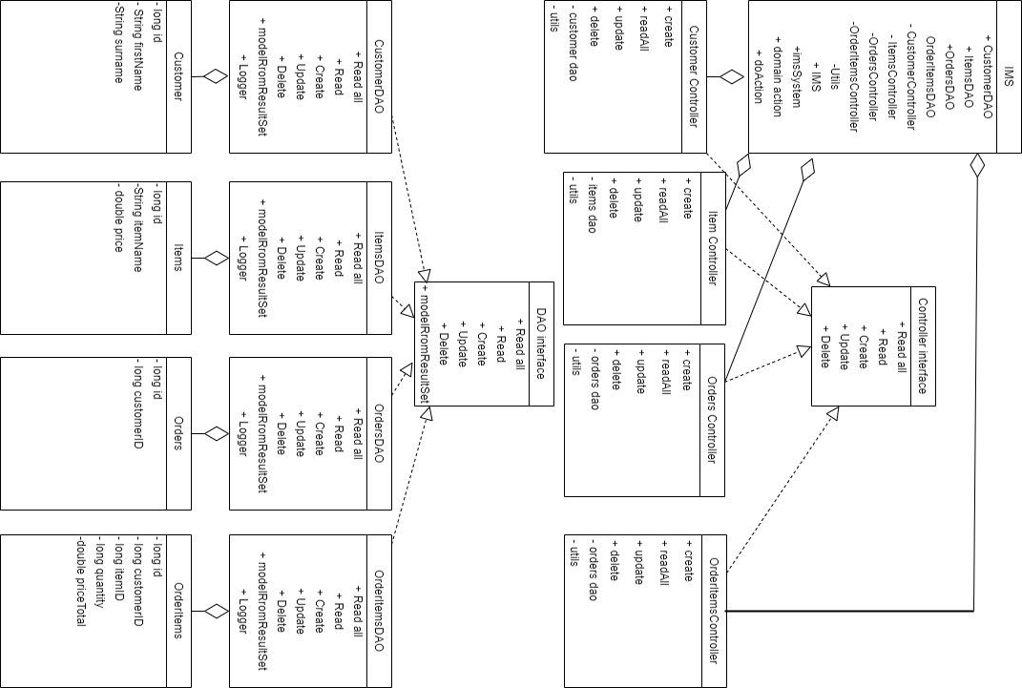
UML diagram

Slide 8
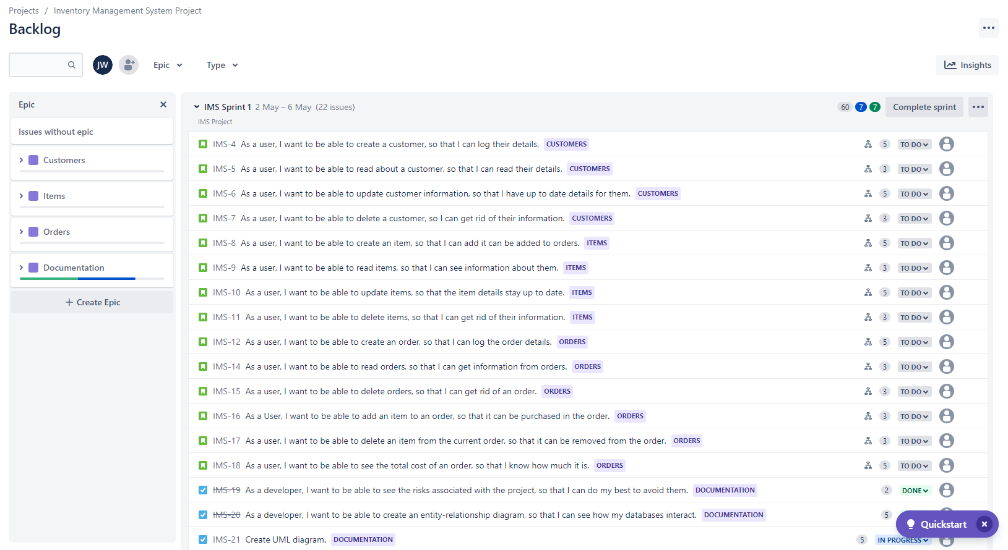
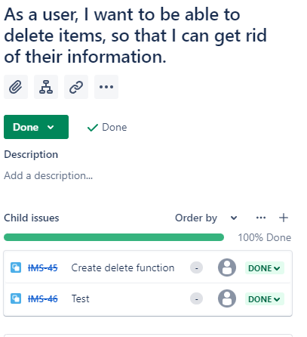
Jira Board - 1 week sprint

Slide 9
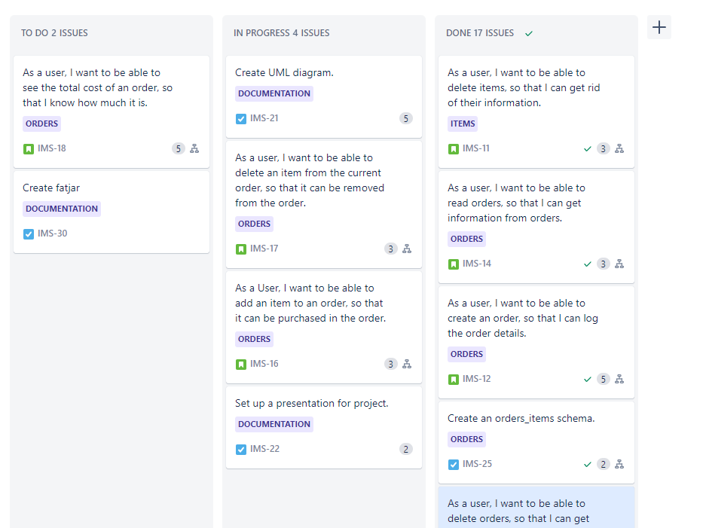

Slide 10
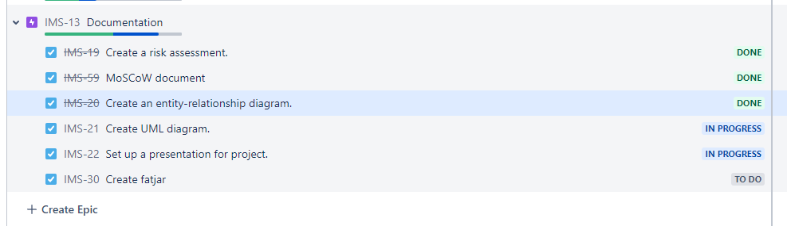
Jira Tasks

Slide 11
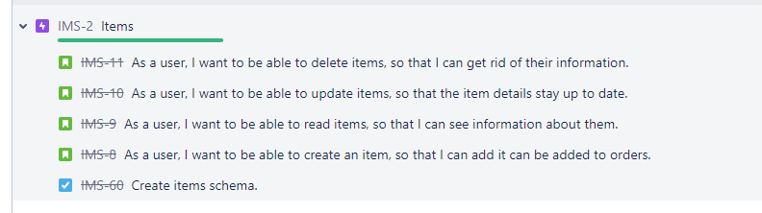
Jira - User Stories

Slide 12
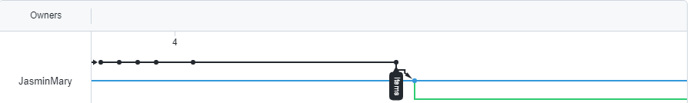
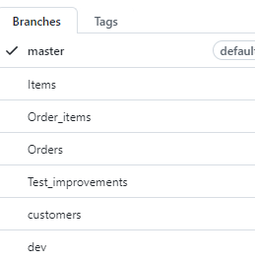

Github

Slide 13
Developer Journey
Skills needed for the project:
Programing and Java knowledge
Database and mySQL understanding
Agile project management
Version source control knowledge
Skills Learned:
Developed Java understanding
How to use mySQL
Further developed agile methodology, and use of git
How it allowed me to complete the project:
Couldn’t complete this task without Java or mySQL knowledge
Further practice with version source control allowed me to correctly use it and make a perfect feature branch model.
The agile way allowed me to take a more flexible approach to this task.

Slide 14
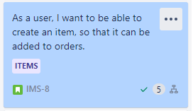

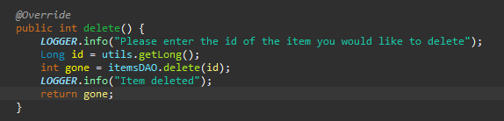
Version Control
git commit -m ‘fulfilled user story - As a user, I want to be able to create an item, so that it can be added to orders. Added create functionality for items’
git checkout -b dev
git checkout -b items

Slide 15
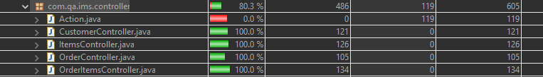

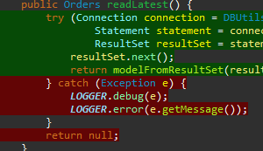
Test Coverage
Controller test coverage:
DAO test coverage:
Currently at 82% combined

Slide 16
CRUD functionality
Wanted to be able to create, read, update and delete for customers, orders and items.
Created user stories sound these functions
Used unit and integration tests to test the functions

Slide 17
Unit Testing
Tested all functions I created and one that was missed out of customers.
Currently haven’t fixed the unit tests for OrderItemsDAO because of an SQL syntax issue.
Didn’t manage to test the catches blocks in the try catch exceptions for DAO classes.
Used mockito to mock the DAO classes and to verify that methods were being used when called.

Slide 18
Demo

Slide 19
Sprint Review
What went well:
Testing!
Using version source control
Using jira and agile
What didn’t go so well:
SQL - I need to practice!
Mismanaging my time - got stuck on something for over half a day.
I thought I’d be able to achieve more than I did.
What I can learn going forward:
I have a better estimation of my skills and the time it takes to do certain tasks.
I need to practice SQL

Slide 20
Thank you for listening!

